Slide 1
GRAPH THEORY ON CYBERSECURITY USING GRAPH NEURAL NETWORKS
Group -15
Nikhitha Kunduru 11602269
Sahithi Mamidipally 11673472
Jyothika Raj Samineni 11591327
Rashmika Adusumilli 11770425

Slide 2
Context
Introduction
Problem Statement
Implementation
Evaluation
Result
Risk and Challenges
Conclusion

Slide 3
Introduction
Graph based machine learning has been more in use because it understands all the complex connections in the data in a clear manner.
For handling data structured like networks Graph Neural Networks are preferred(GNN’s). These GNN’s are like deep learning. They have been used in many fields like in social media, biology, etc.
For making it(GNN’s) easy to use they built a toolkit named PyTorch Geometric, it was built on PyTorch.
In this particular research, we are using PyTorch Geometric for testing a graph neural network.
It includes graph convolutional layers (GCNConv) and other few PyTorch Geometric tools.
We use different parts of data and run experiments over 150 training rounds.
Our aim is to see how well the model learns and also will learn how it will handle new data.

Slide 4
Problem Statement
There is improve in technology, cybersecurity is always evolving but still hackers keep coming up with new and sophisticated attacks where the defence techniques does not work.4
Tough there are many static rules and signatures these are not enough to handle these complex threats.
These problems highlights that we need more innovative solutions that adapt to the changes in a faster way.
For addressing these challenges Graph Neural Networks (GNN) are been used, this is done by analysing the current structure of the data.
However more research is required for improving the GNN algorithms mostly for cybersecurity for defending the latest attacks.

Slide 5
Implementation
Data collection and preprocessing: Get the data ready for GNN model by gathering the cybersecurity data.
Model design and Training: For cybersecurity create a GNN model by mainly concentrating on threats in network data. Train it using the prepared data.
Model validation: Using a real cybersecurity data test the trained model to see how well it works.
Advanced techniques: Try fancy methods like graph embedding and attention mechanisms for making a better model.
Integration: make sure that the model smoothly fits into the existing cybersecurity systems.
Collection and feedback: Make sure that the model is practical and effective by working with cybersecurity experts.
Evaluation and Tweaks: Check the accuracy by seeing how well the model performs and work on if there are any adjustments.
Implementation: Put in use the final model for improving the cybersecurity and keep the digital systems safe from cyber threats.

Slide 6
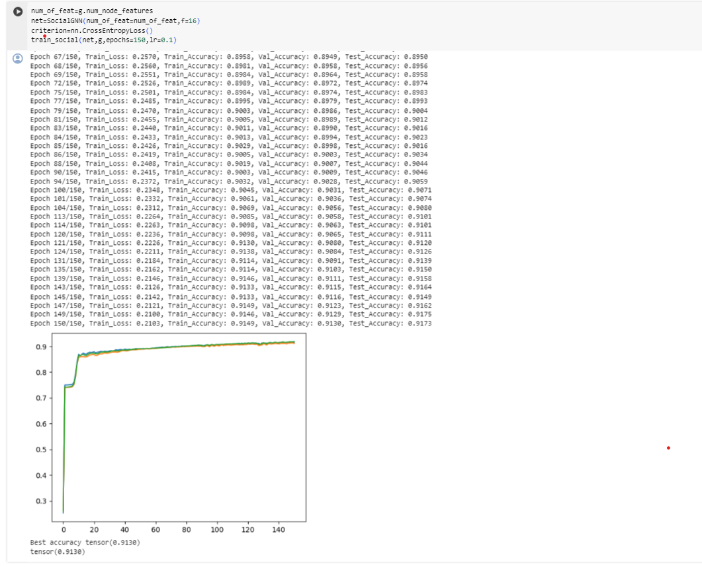
EVALUATION
-Evaluation will operates and find the efficiency for the neural network operations and makes the security and it implements.
-This model validates the accuracy ,precision, recall and f1 score for the threats and many more breaches which use the data sets and make in the real time world.
-Mainly ,Cyber security will proves the NN and make create the model which happened to run and see the application can be used in the real world with all the cyber security problems.

Slide 7
Result
A neural network was trained over 150 iterations using a dataset.
For the 1st iteration 3770 samples are been used.
11,310 samples are used for validation and for testing the system 22,620 samples are used.
For training, validation and testing the datasets performance measures like loss and accuracy were been checked from time to time.
By the change in time the training loss is been reduced which shows that the model is learning.
The accuracy is been increased to 91.49%.

Slide 8
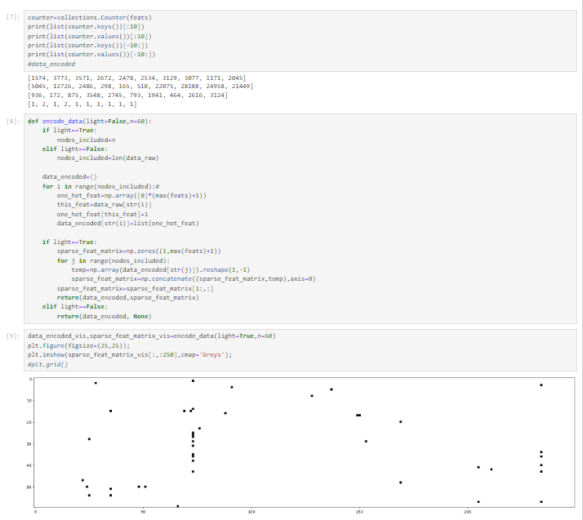
Through out the training process the accuracy on both validation and test datasets consistently increased.
This leads to signs of overfitting and generalization.
This says that the model was able to learn patterns from training data and effectively use it to new unseen data.
With the test accuracy of 91.73% and the validation accuracy of 91.30% the model performed good on different datasets.

Slide 9
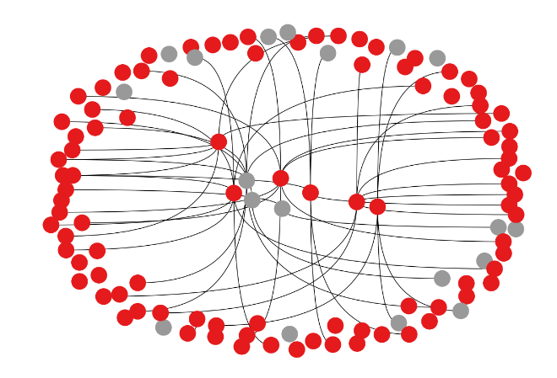
The graphical plot of the report shows the analysis of training and evaluation dynamics of a neural network model at various epochs.
At first the validation loss decreases but then it will be stable, it suggests the diminishing returns and potential overfitting.
The models improvement over the time is seen as the fine tuning plots.
Such visualizations helps to understand the model during training and make decisions to prevent overfitting.

Slide 10
Risk and CHALLENGES
There are few challenges in using Graph Neural Networks for cybersecurity.
For making sure that it is compatible with the existing systems and data sources, the collaboration is required between cybersecurity and machine learning experts.
For any GNN decisions computational power for training an interpreting is essential.
It is crucial to understand how graph neural networks make decisions for building trust and adoption in cyber security.
GNN have the great scope in the privacy issues when we deal with the data and the network issue happen in the traffic .
When it come to the GNN we have the most challenge when it come to the decisions. Which make crucial for the detection and decisions.
Mainly in the graph neural network which have the complex analysis in the cyber attacks and make the better decision in process.

Slide 11
Conclusion
In this study we used PyTorch Geometric to build and test a neighbourhood based neural network, this worked good in node sorting.
The models based on graph convolutional methods helps in leaning the complex structures and connections in data effectively.
These make contributions in the evolving field of graph based techniques which are mostly used in biology and social network researches.
The recourse usage and scalability are optimized with the help of PyTorch Geometric.
Future research explores different graph neural network designs and datasets with many scenarios to improve model versatility.
Apart from this integrating transfer learning methods could further improve the models application among various domains.

Slide 12
Thank You

